Slide 1
Just Don’t App
Bruno Ross Shab

Slide 2
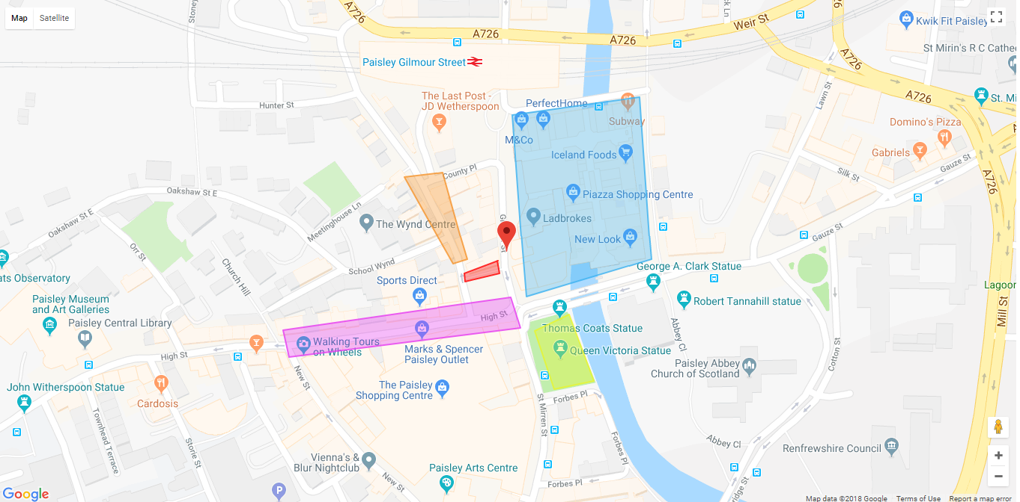
Map
Map

Slide 3
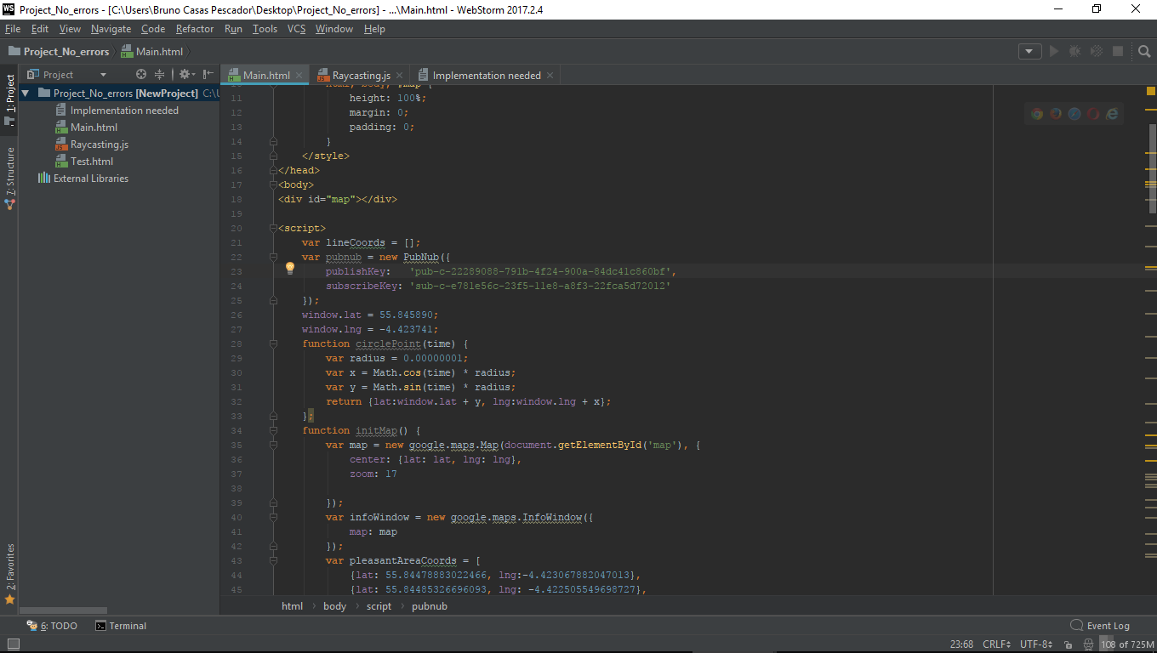
Map
Map code

Slide 4
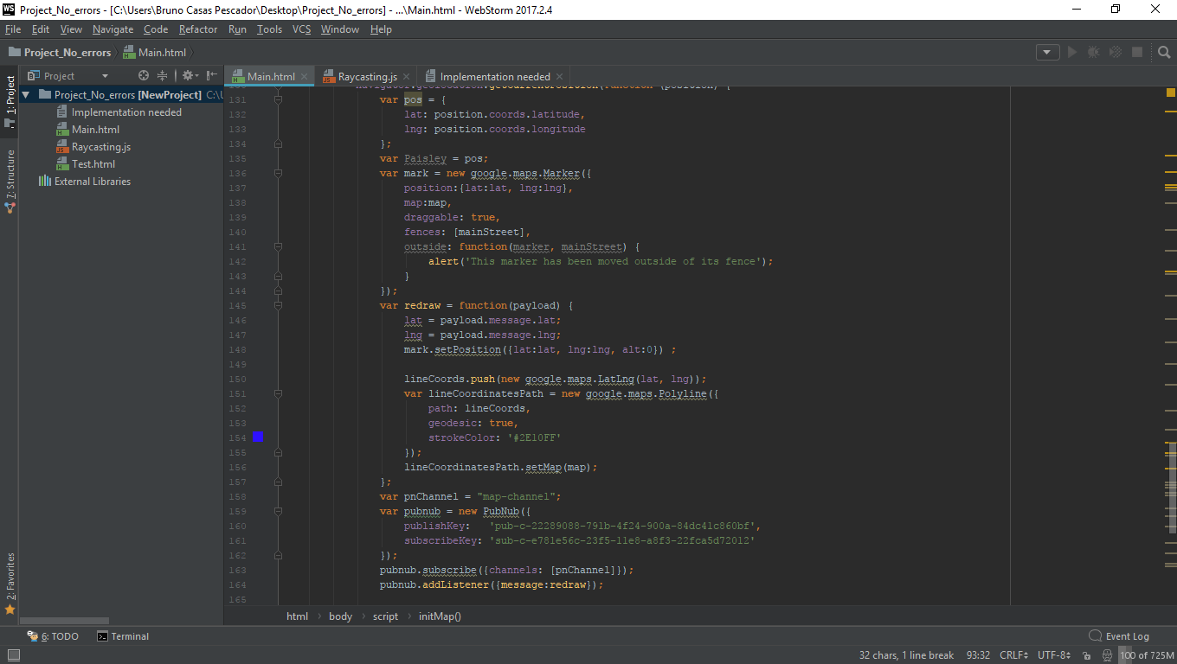
Map
Map code

Slide 5
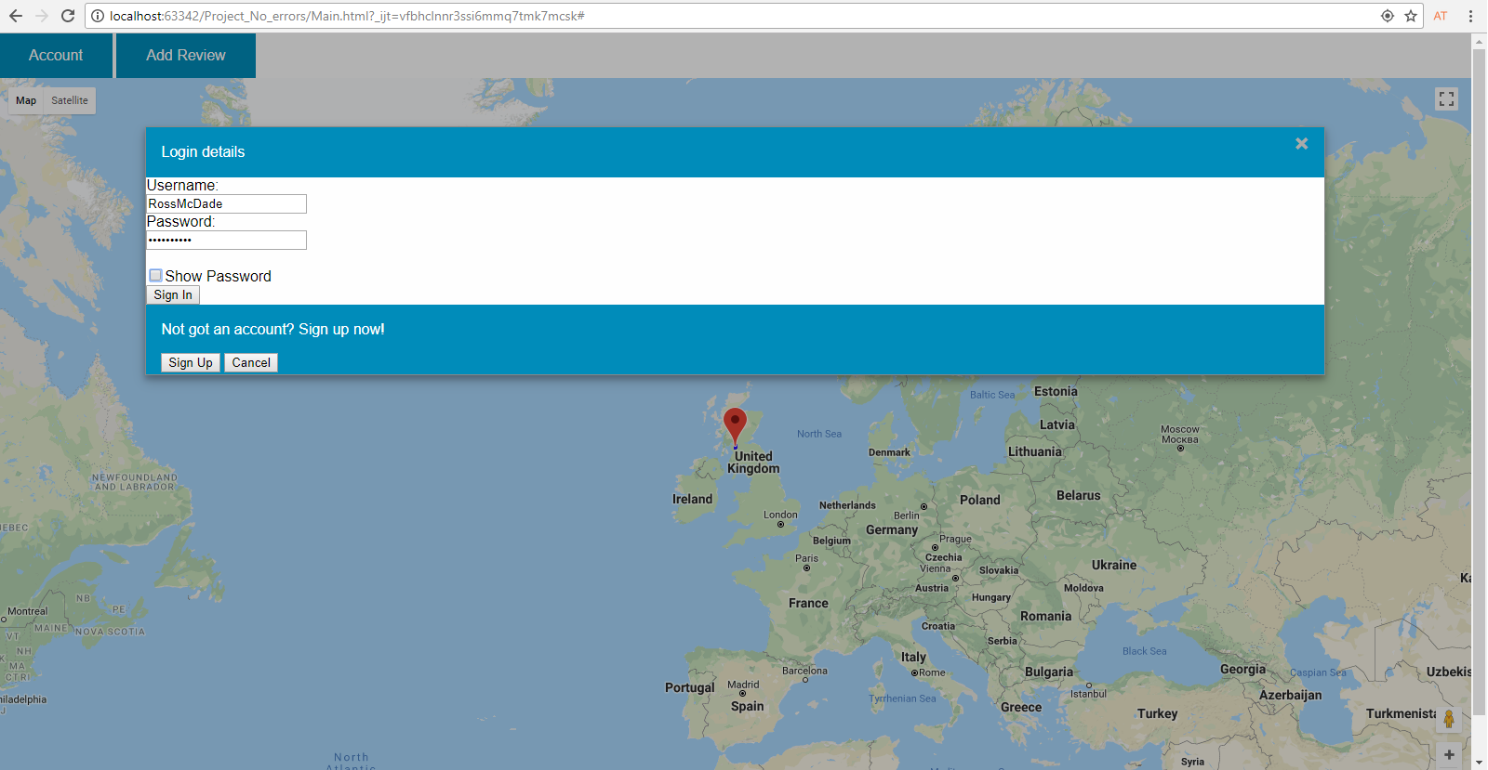

Buttons
Account button

Slide 6
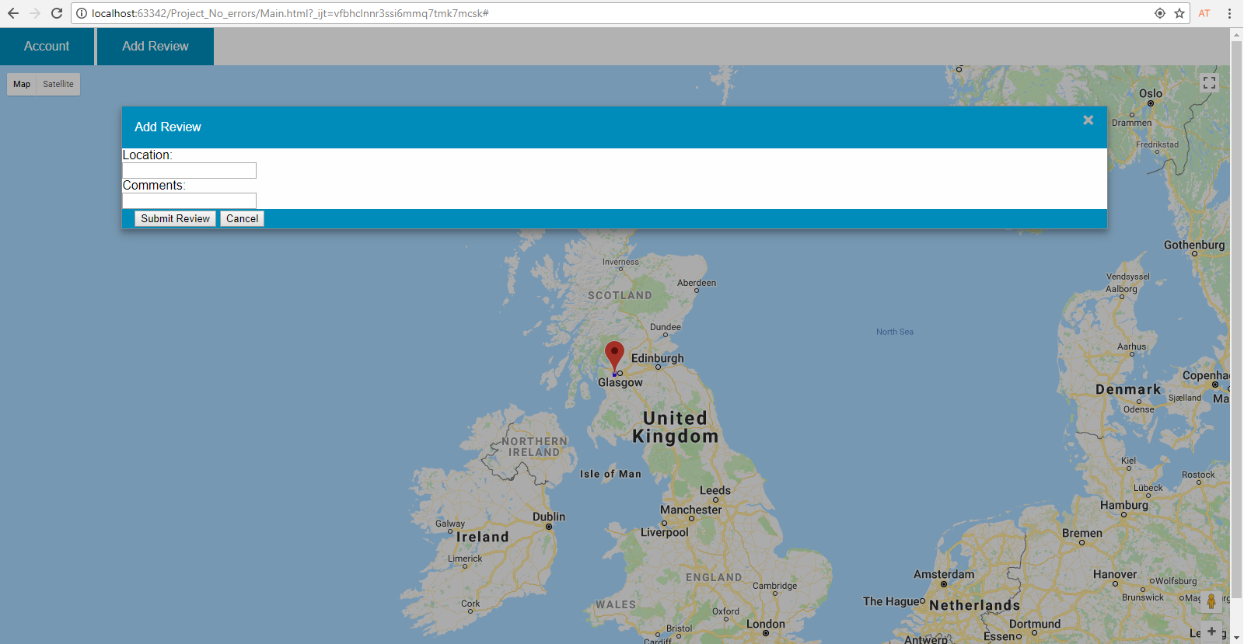
Buttons
Add Review button

Slide 7
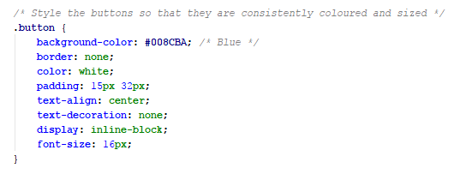

Buttons
Button code

Slide 8
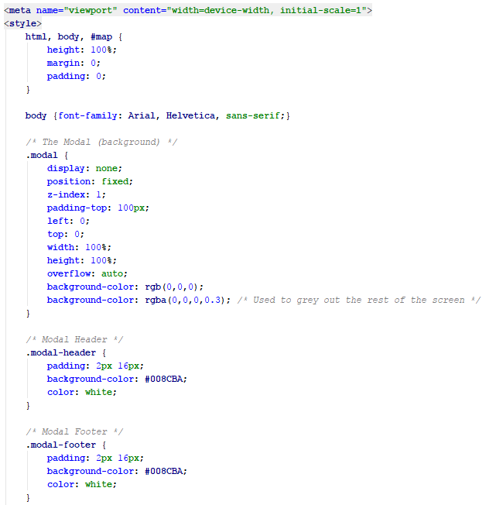
Modals
Modals CSS code

Slide 9
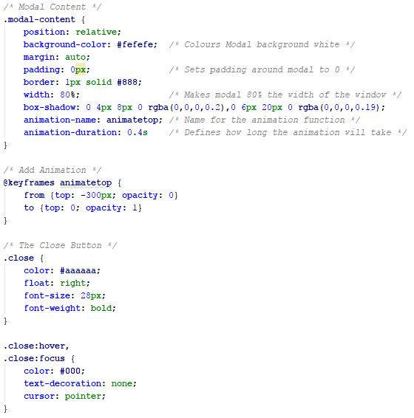
Modals
Modals CSS code

Slide 10
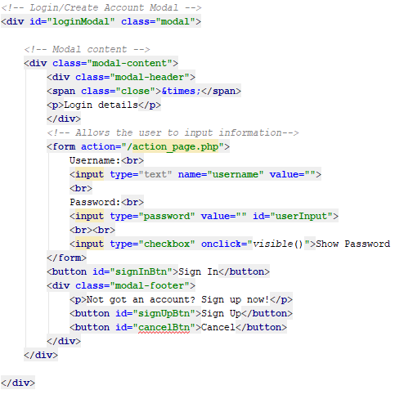
Modals
Login Modal code

Slide 11
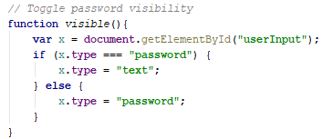
Modals
Login Modal code

Slide 12
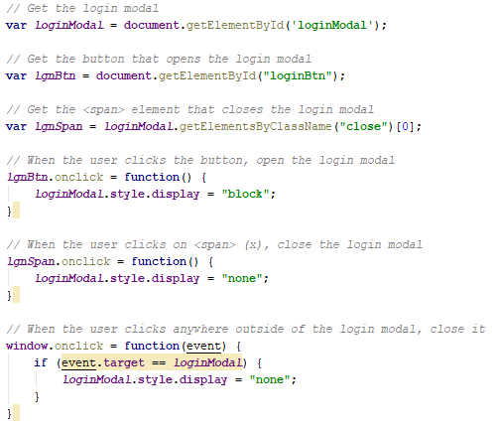
Modals
Login Modal code

Slide 13
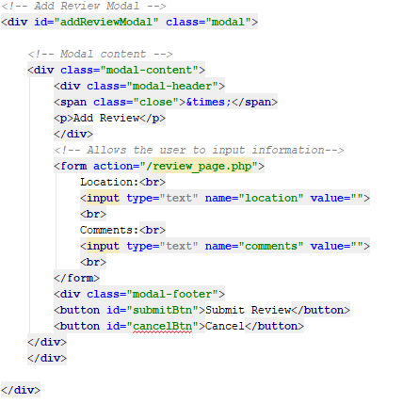
Modals
Add Review code

Slide 14
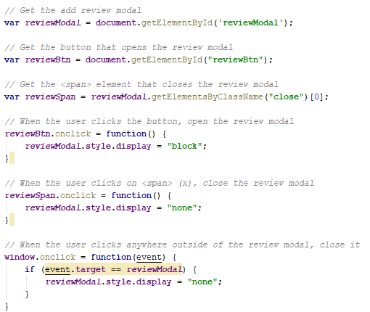
Modals
Add Review code

